Slide 1


Tanzanian Waterpoint Status Prediction
Enabling directed local action through machine learning

Slide 2
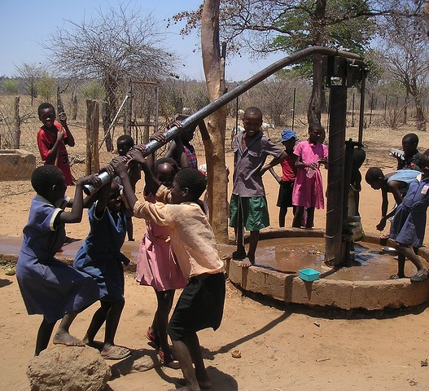
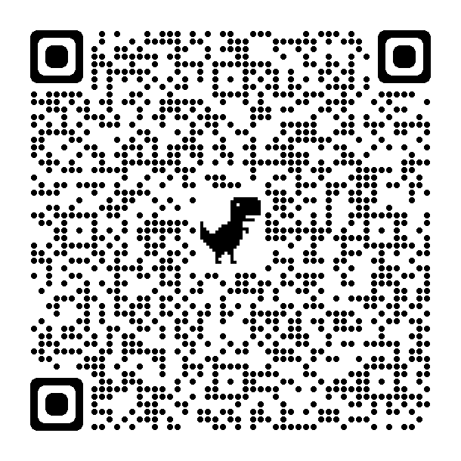
Current Problem
70% of the country’s population lives in rural areas, where access to clean water covers only about 45% of the population
International efforts are focused on improving this access through maintenance and new installations

Slide 3
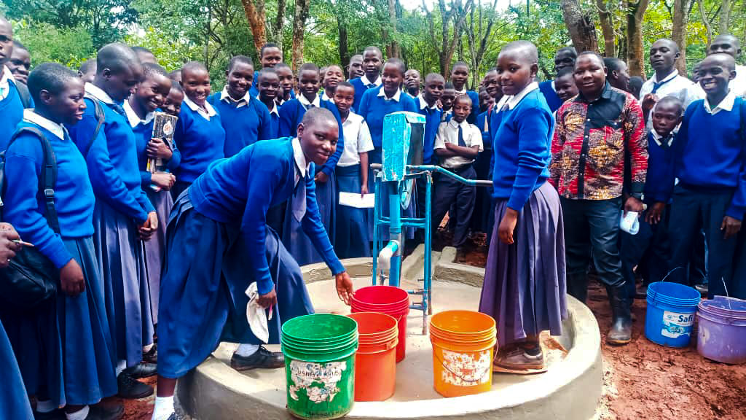
Business Understanding
Tanzania Development Trust (TDT) focuses on small projects with local involvement
Current rural water development focuses on borehole and rope pump installation in NW region
New benefactor wants to increase scope of project
Wells are easier to repair than replace
Identify concentrations of failed waterpoints
Tasked with modeling well status to assist in allocating resources accordingly

Slide 4
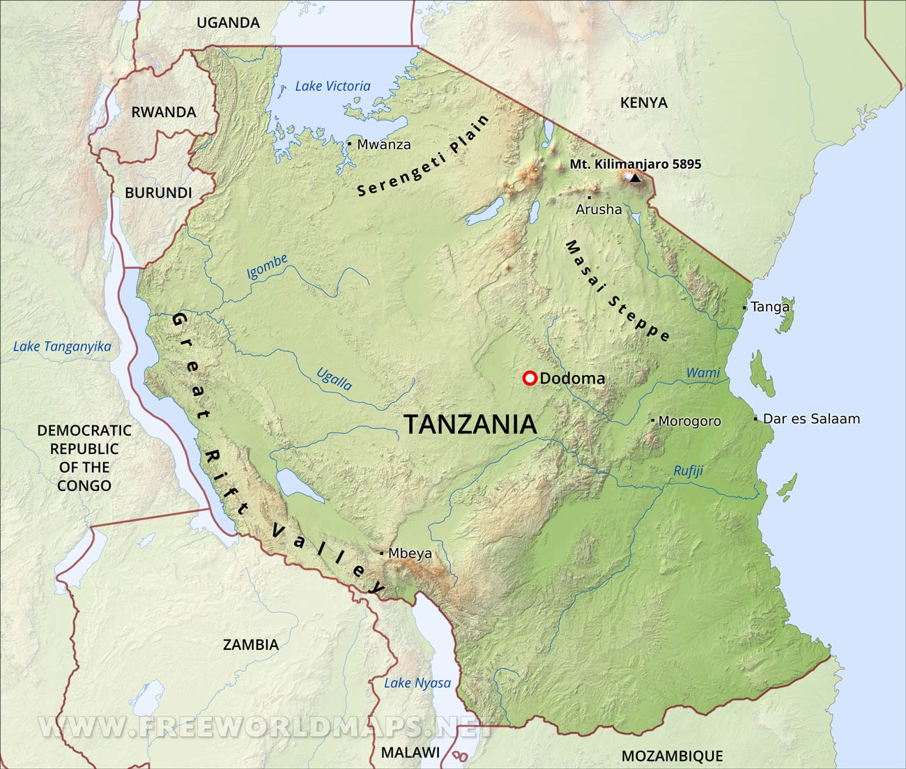
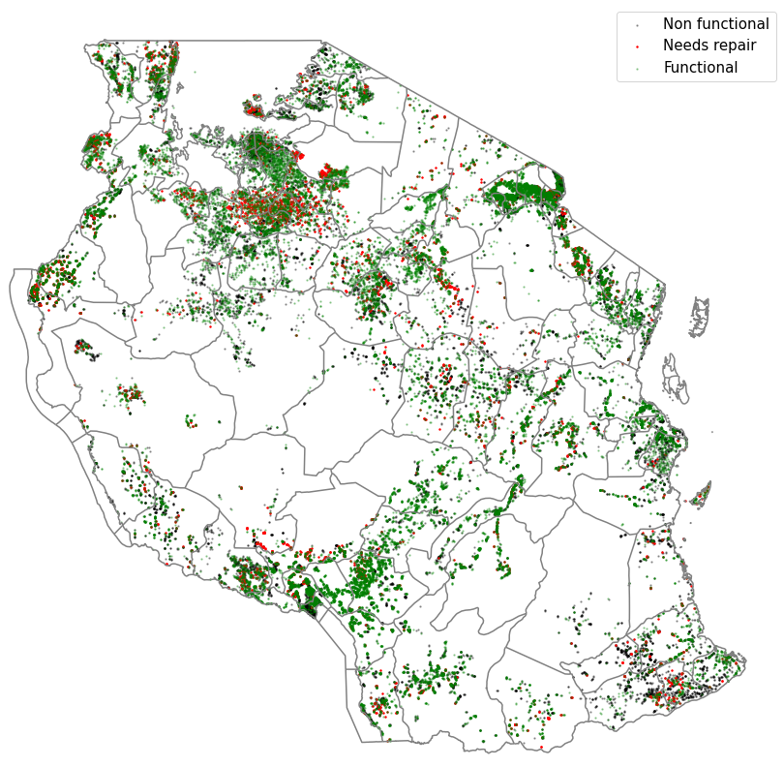
Data Brief
Data source: Taarifa waterpoints dashboard
aggregate data from the Ministry of Water
Features include geographic data, extraction information, operational and source data
59,400 entries recorded between 2011 and 2013

Slide 5
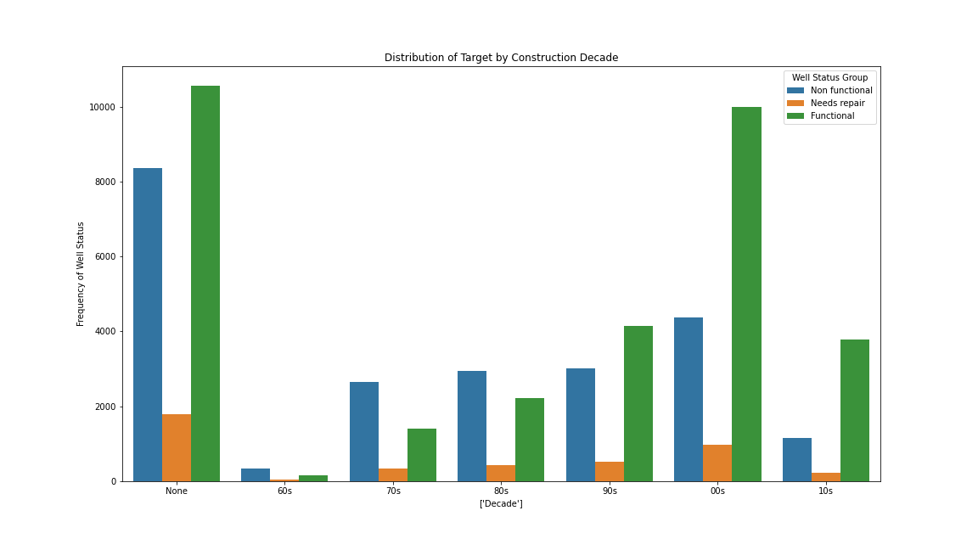
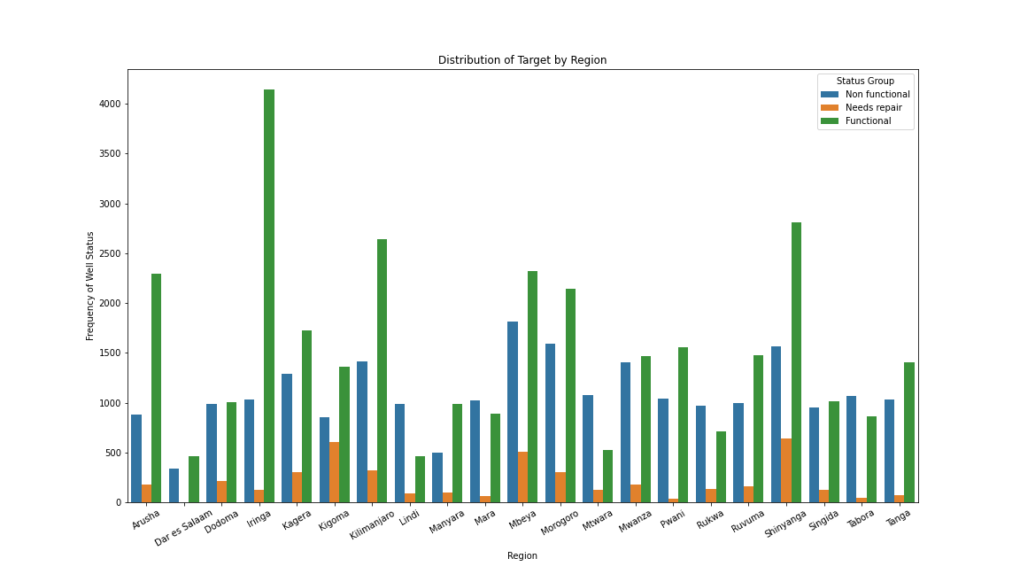
Initial Insights
Aging waterpoints have an increased share of non-functional status but a decreased needs repair status
Regions in the northwest experience the highest share of waterpoints needing repair
Southeast regions see the largest share of non-functional waterpoints

Slide 6
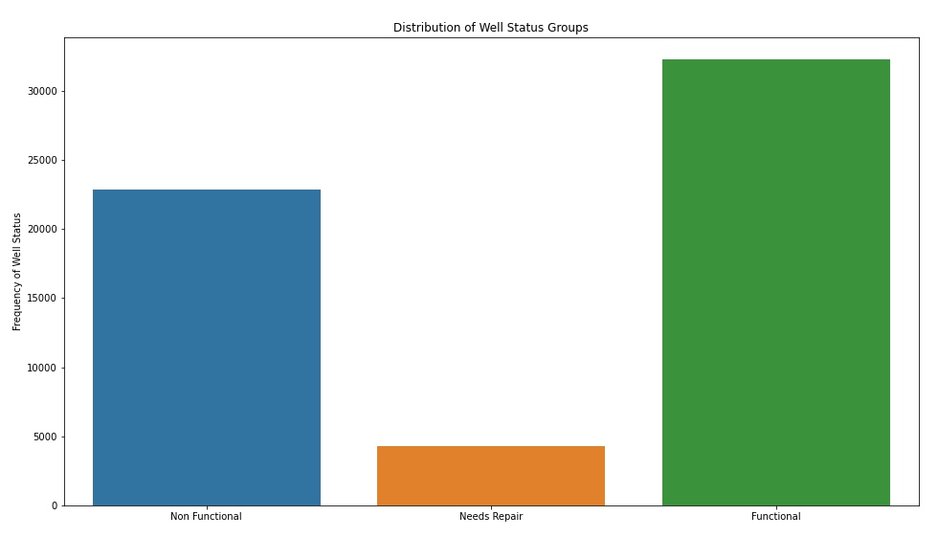
Modeling Process
Begin with a simple baseline model for comparison
Iterative progression in successive models
GridSearch
Target weighting
Classification reports and confusion matrices used for evaluating and comparing models

Slide 7
Model Selection
Models struggled with identifying minority class
Selected XGBoost for classification modeling
Best metrics for finding repair sites
Functional wells misclassified as needing repair are still an opportunity for preventative maintenance
Speed of processing makes it ideal for eventual production on a dashboard
Other models offer higher total accuracy at the cost of misidentifying repair

Slide 8
Feature Understanding
The quantity of water available to a well is the most impactful feature
Physical location also has a large impact on the status of a waterpoint
Other impactful features include extraction type and the well height

Slide 9
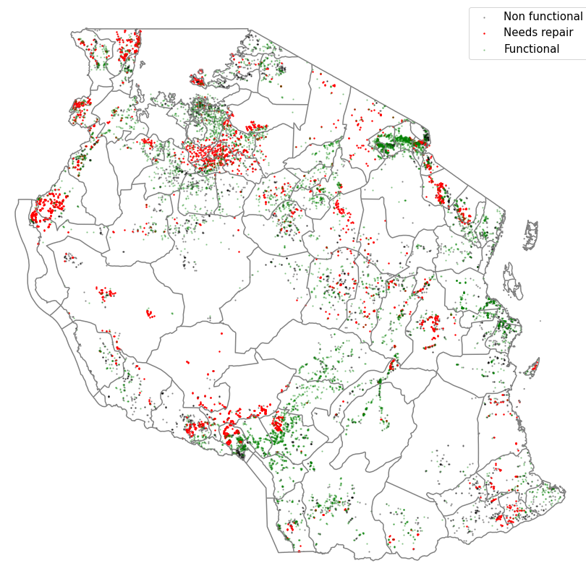
Recommendations
Expand well repair operations to Shinyanga
Future project expansion to Mbeya
New well construction in Mara and Mwanza
Install handpump wells
Communal standpipes with multiple waterpoints

Slide 10
Questions?
https://github.com/brtracy/phase_3_project
brtracy1984@gmail.com

